Slide 1
Fraudulent Transaction Identification
Melvin Wong
Data Science Intensive Capstone Project, January 2024 cohort

Slide 2
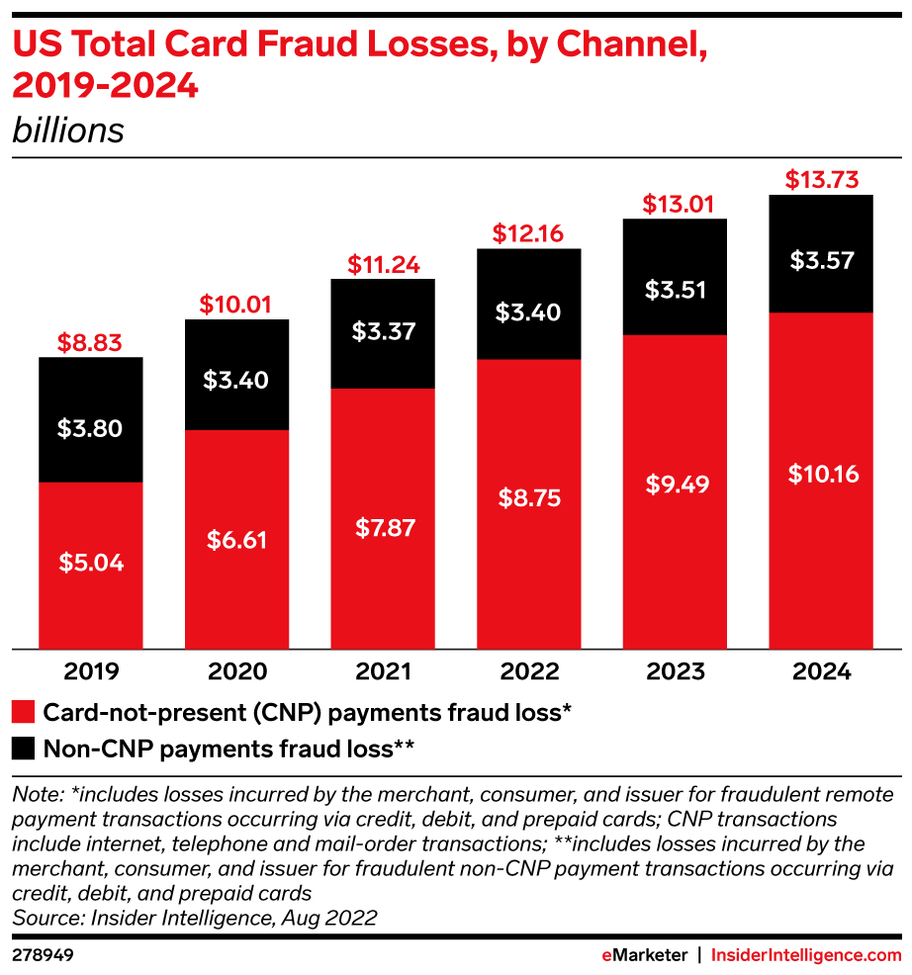
The Problem
Increase of total card fraud losses and transactions has increased year over year.
What factors best determine credit card fraud transactions?
Can we predict what transactions are credit card fraud?

Slide 3


Who might care?
…and many more….

Slide 4
What factors affect fraudulent transactions?
Distance
Category type
Time of transaction
Data source: Credit Card transaction (fraudulent & not fraudulent)

Slide 5
Data Source
Data acquired for the period: January 2019 – December 2022
Credit Card Transactions: Credit Card Transactions across the US
Number of records: 444,719
Number of fields: 22

Slide 6
Data Exploration https://github.com/melvinhwong/Capstone-Two/blob/main/Exploratory%20Data%20Analysis%20(EDA).ipynb
Credit Card transaction
Transaction category
Merchant name
Customer age
Merchant location (longitude & latitude)
Customer location (longitude & latitidue)
Transaction identified as fraud (1 – yes & 0 – no)

Slide 7
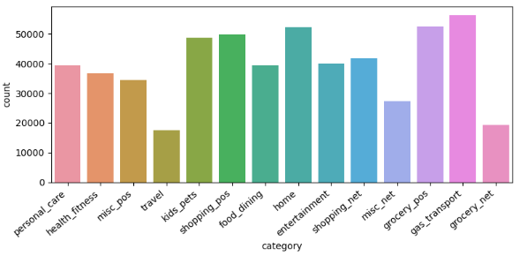
Transaction Category Distribution
Transactions category is evenly distributed

Slide 8
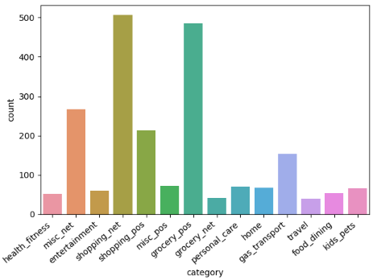
Fraudulent Transaction Distributed
Transactions identified as fraud:
Misc_net
Shopping_net
Grocery_pos
Gas_transport

Slide 9
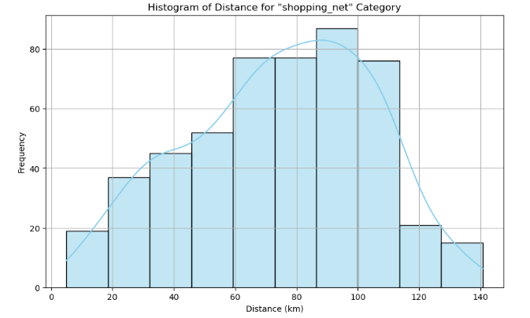
Histogram of distance for “shopping_net” category

Slide 10
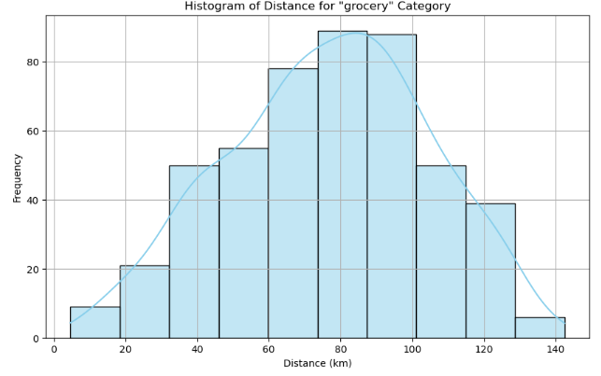
Histogram of distance for “grocery” category

Slide 11
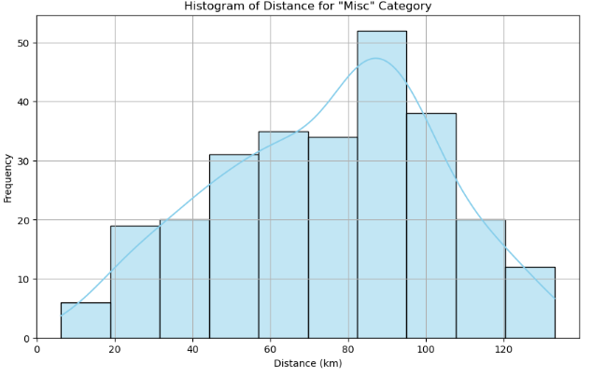
Histogram of distance for “misc” category

Slide 12
Machine Learning Modeling https://github.com/melvinhwong/Capstone-Two/blob/main/Modeling.ipynb

Slide 13
Modeling Overview
Type: Supervised learning
Binary classification: 1 for fraudulent transaction and 0 for non-fraudulent transaction
Tools: Python’s scikit learn and model

Slide 14
Modeling steps
Data pre-processing steps:
Label encoding
Data splitting into training and test sets (70% - 30 %)
Resampling or weighting the training data
Scaling
Models used:
Logistic Regression
KNN
SVM
Random Forest
Gradient Boost
Naïve Bayes

Slide 15
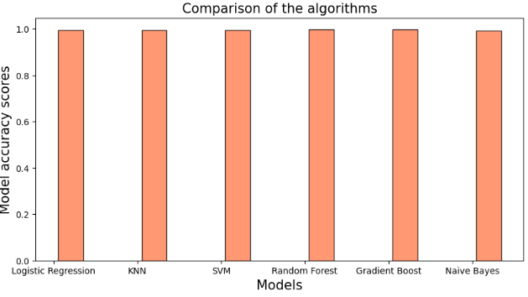
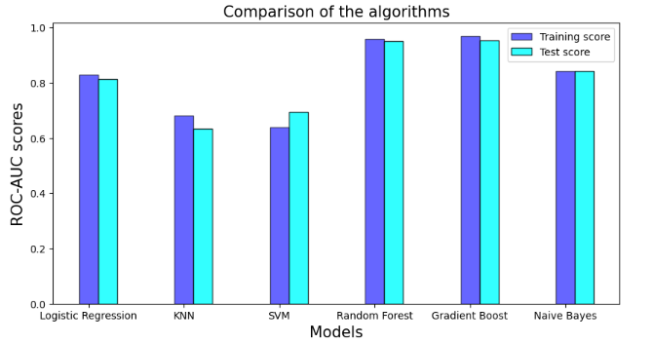
Model Comparisons

Slide 16
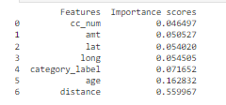
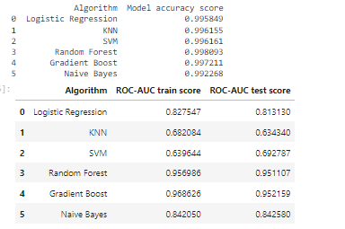
Model Comparisons (cont.)
Feature importance
Model scores (ROC-AUC)

Slide 17
Assumptions, Limitations and Disclaimers
Credit card fraudulent transactions are evolving since 2020
Used only two years of data
Due to the ever changing transaction fraudulent world and ways to circumvent monitoring
Does not contain all credit card data and so transactions may be skewed

Slide 18
Conclusion
Out of the 23 factors, three (3) were the most important:
Distance
Age
Category Label
Out of the six (6) best models, the two best models were:
Gradient Boosting
Random Forest

